Slide 1
INTEGRITY CHECKER

Slide 2
TEAM MEMBERS AND THEIR CONTRIBUTION:
S.NO | NAME | REGISTRATION NUMBER
1) | Yakkala Tarun Sai | AP18110010469
2) | B.V.S.Neeraj | AP18110010474
3) | M.Sri Krishna Kumar | AP18110010506

Slide 3
INTRODUCTION:
Integrity checker can be formally defined, as, if person-A is sending a message to person-B, then there
shouldn’t be any kind of third person’s view or access is not allowed. So we basically involve three
main triads
i.e,Integrity,Authenticity,confidentiality.
Authenticity and integrity are used for message authenticity and confidentiality is also maintained in the project so that the third person is not allowed to view our messages or information.
Our project “Integrity Checker” targets in developing a chat system with data integrity and sender
identification validation.
We used different cryptographic techniques and algorithms in this project to show valid output.This is a chat system in which message is passed between the sender and receiver.The process between this
sending and receiving is being created and monitored in this project.
By implementation of this project all the CIA(confidentiality , integrity and authentication)triads can be
maintained.

Slide 4
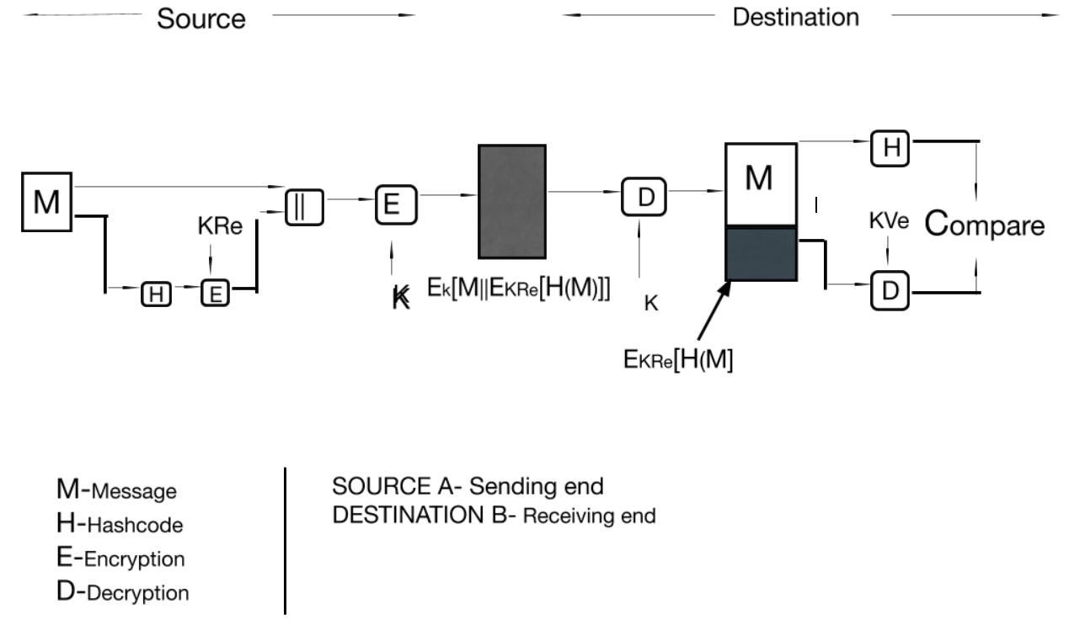
WORKING:

Slide 5
This application deals with a Source and Destination, i.e, here Source refers to sender and Destination refers to receiver, when message is sent from sender to receiver then the message will goes through the hash function, and the generated output undergoes RSA encryption using the private key of the sender.
Then in the next step the original message given as input is appended with the output generated from the RSA encryption.
After appending the output will be encrypted using the AES algorithm. By using TCP/IP Server and Client system message will be transferred to the receiver then the sent message will be decrypted using AES algorithm then we get the decrypted output that will be divided into two parts.
The first part which is the original message is sent into the hash function and the rest half part undergoes RSA decryption using a public key. Both the generated outputs i.e, the output generated from RSA decryption and the output generated from the hash function are compared.
If both the outputs are the same then we say that the integrity is maintained.

Slide 6
PROPOSED SYSTEM:
This project is implemented using python(3.7 and above)
Inbuilt Libraries used in project: socket
Crypto
hashlib
binascii
base64

Slide 7
Algorithm(Without TCP/IP)
STEP-1: Take the input/Plain Text from the User.
STEP-2: Implement Different Cryptographic Algorithms for Encryption of the Plain Text
i) Implement Hash Function on the Plain Text given by the user.
ii) Implementation of RSA Encryption is done on the output generated from the hash function.
iii) RSA Encryption is implemented on the output of Hash function and the output of the RSA Encryption is appended to the original input/Plain Text.
*** Output of the RSA Encryption is appended to the original input/Plain Text=Cipher Text***
STEP-3: Implement the Decryption process of the above mentioned Cryptographic Algorithms in the following order:
i) AES Decryption is implemented on the Cipher Text.
ii) After AES Decryption we get original message/Plain Text appended with the output generated from the RSA Encryption as output.
iii) Implement hash function on the original message/Plain Text which is generated after the AES Decryption.---> 1
iv) Implement RSA Decryption on the RSA encrypted hash value of the input message from the output generated by AES Decryption--->2
STEP-4: Compare both 1 and 2 and:
if there are equal:
Successful implementation
else:
Error in the code.

Slide 8
Algorithm(With TCP/IP)
STEP-1: Take the input/Plain Text from the User
STEP-2: Implement Different Cryptographic Algorithms for Encryption of the Plain Text
i) Implement Hash Function on the Plain Text given by the user.
ii) Implementation of RSA Encryption is done on the output generated from the hash function.
iii) RSA Encryption is implemented on the output of Hash function and the output of the RSA Encryption is appended to the original input/Plain Text.
*** Output of the RSA Encryption is appended to the original input/Plain Text=Cipher Text***
STEP-3: Using TCP\IP protocol we send the message from one device to another device.
STEP-4: Implement the Decryption process of the above mentioned Cryptographic Algorithms in the following order:
i) AES Decryption is implemented on the output of the TCP\IP protocol.
ii) After AES Decryption we get original message/Plain Text appended with the output generated from the RSA Encryption as output.
iii) Implement hash function on the original message/Plain Text which is generated after the AES Decryption.---> 1
iv) Implement RSA Decryption on the RSA encrypted hash value of the input message from the output generated by AES Decryption--->2
STEP-5: Compare both 1 and 2 and:
if there are equal:
Successful implementation
else:
Error in the code.

Slide 9
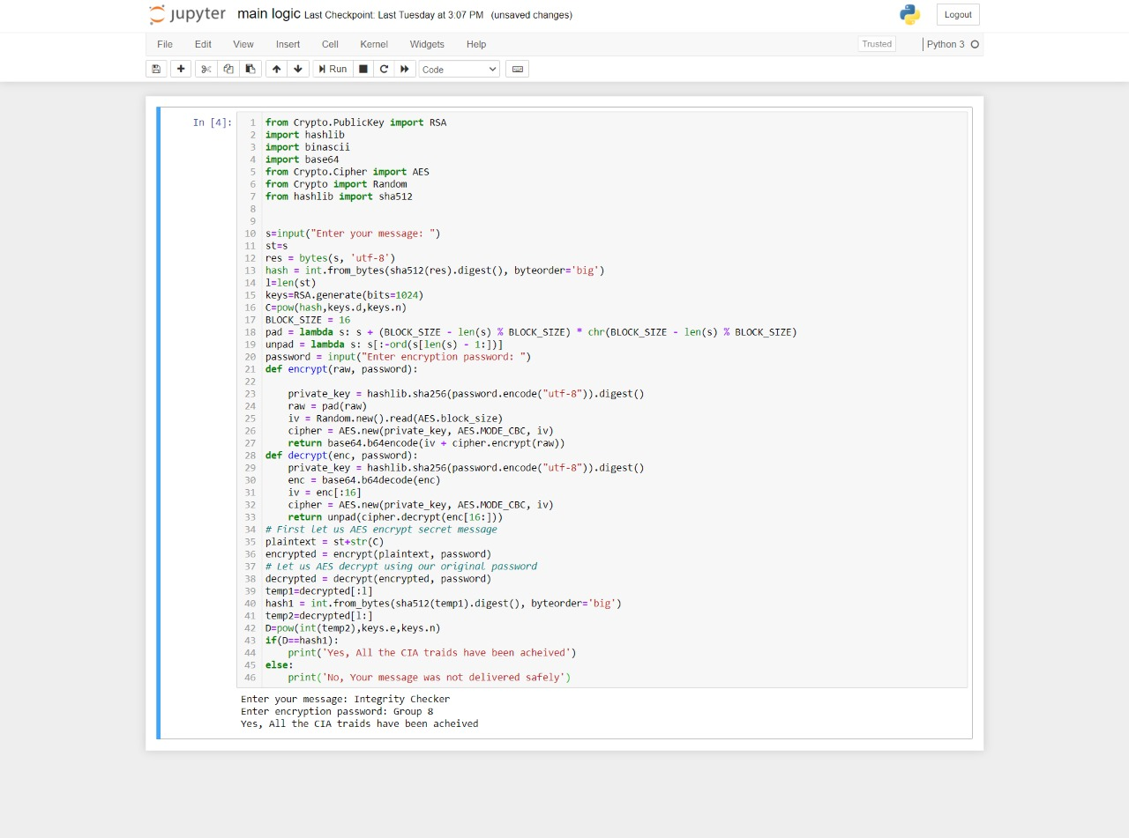
Performance Analysis

Slide 10


Output Screenshots

Slide 11
Thank You

